Slide 1
Digital Image Processing Technology and Application
Object Recognition

Slide 2
The Basic Idea
Object Recognition: Classification & Clustering
Objects characterized by one or more features
Classification
Have labels for some points
Want a “rule” that will accurately assign labels to new points
Supervised learning
Clustering
No labels
Group points into clusters based on how “near” they are to one another
Identify structure in data
Unsupervised learning
Feature Y
Feature X

Slide 3
Features & Classifier
Features: can be regarded as the descriptors we introduced before.
Representation useful for classification:
Easy to extract (reliable)
Strong edges, area, etc…
Specific for the classes
Green pears vs. red tomatoes
Classifier: Algorithm/device that separates objects into different classes.

Slide 4
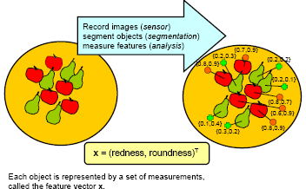

Features
Feature is important!!!
$$ωω$$
Each object is represented by a set of measurements, called the feature vector x.

Slide 5
Feature Space
The set of all possible patterns forms the Feature vector.
Each feature vector is a point in the so-called feature space.
Similar objects yields similar measurement results (feature vectors). Nearby points in feature space correspond to similar objects.
Distance in feature space is related to similarity.
Points that belong to the same class form a cloud in feature space.

Slide 6
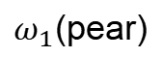

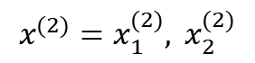
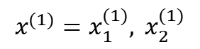
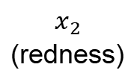
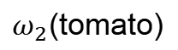


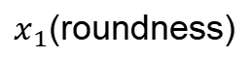
Feature Space
$ω_{1}$(pear)
$$ωω$$
$$ωω$$
$$x^{(1)}=x_{1}^{(1)}, x_{2}^{(1)}$$
$$x_{2}$$
(redness)
$$ωω$$
$$ωω$$
$ω_{2}$(tomato)
$$ωω$$
$x_{1}$(roundness)
$$x^{(2)}=x_{1}^{(2)}, x_{2}^{(2)}$$
$$ωω$$

Slide 7
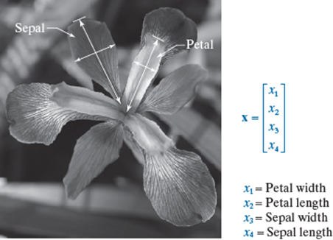
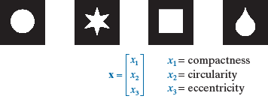
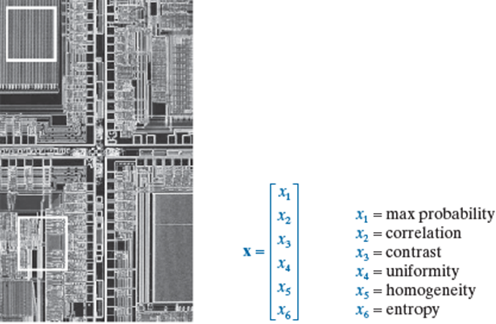
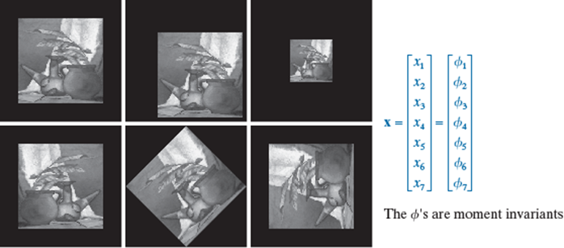
Feature Space
Notes:
鸢yuān尾花：花瓣的宽度、长度，花萼的宽度、长度
紧致度、圆度、偏心度

Slide 8
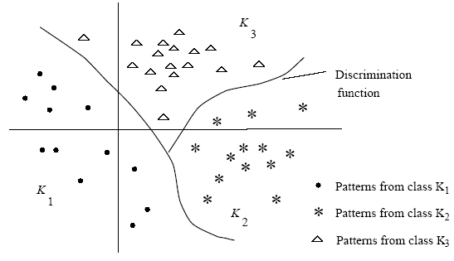
Pattern Classification
R₂
R₁
R₃
III
I
II
I: Linear
II: Piecewise Linear
III: Curves or Hyper-surfaces

Slide 9
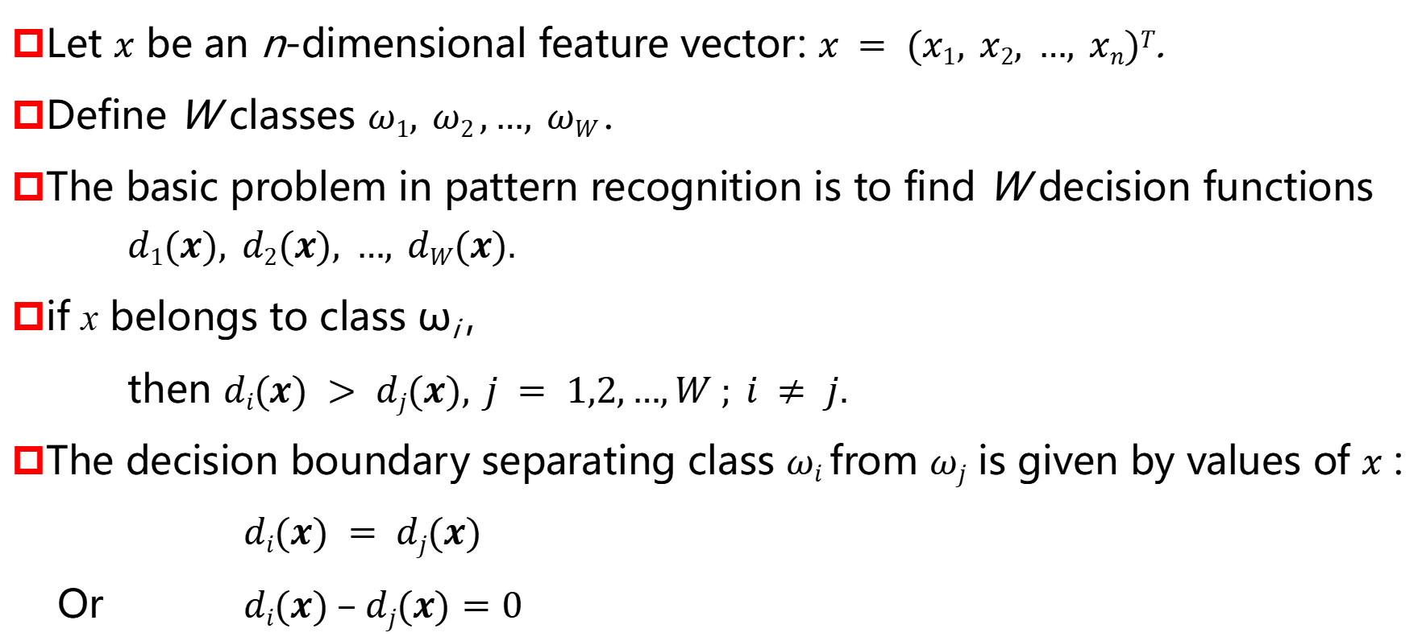
Recognition Based on Decision-Theoretic Method
Let $x$ be an n-dimensional feature vector: $x = (x1, x2, …, xn)T$.
Define W classes $ω1, ω2 ,…, ωW$.
The basic problem in pattern recognition is to find W decision functions $d1(x), d2(x), …, dW(x).$
if x belongs to class ω_{i} ,
then $di(x) > dj(x), j = 1,2,…,W ; i ≠ j.$
The decision boundary separating class $ωi$ from $ωj$ is given by values of $x$ :
$di(x) = dj(x)$
Or $di(x) – dj(x)=0$

Slide 10
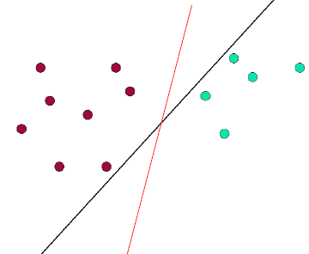
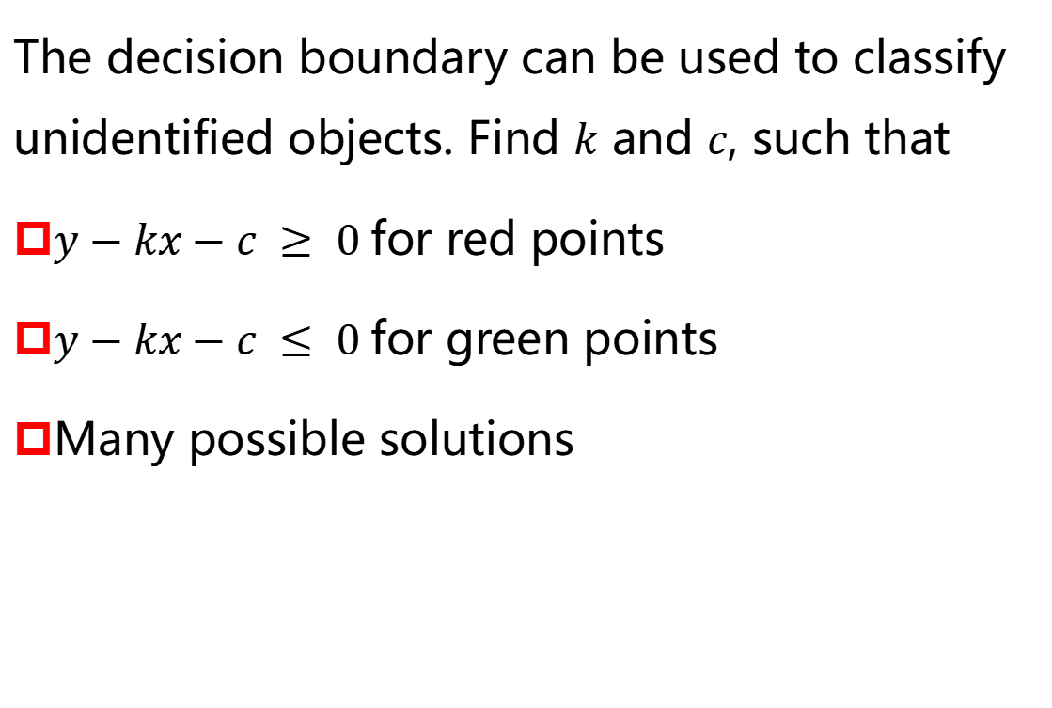
Recognition Based on Decision-Theoretic Method
The decision boundary can be used to classify unidentified objects. Find $k$ and $c$, such that
$y−kx−c ≥ 0$for red points
$y−kx−c ≤ 0$for green points
Many possible solutions

Slide 11
Pattern Classification
The number of classes is usually known beforehand, and typically can be derived from the problem specification.
The classifier does not decide about the class from the object itself — Depend on object properties called patterns (Features).
The classes (clouds) may have wide variety of shapes.
Decision functions specify the boundaries between the clouds. These boundaries can be used for classification of new, unidentified objects.
If two clouds that represent different classes overlap in feature space, then a perfect classification does not exist.
Multiple classes require multiple decision functions.

Slide 12
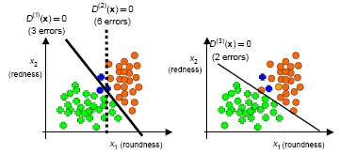
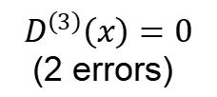

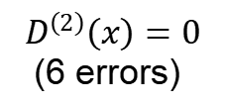
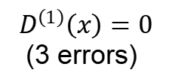




Pattern Classification
Given a decision boundary, we can compute the classification error.
The decision boundary that have minimum classification error is the optimal decision boundary.
$$D^{\left(2\right)}\left(x\right)=0$$
(6 errors)
$$D^{\left(1\right)}\left(x\right)=0$$
(3 errors)
$$ωω$$
$$ωω$$
$$D^{\left(3\right)}\left(x\right)=0$$
(2 errors)
$$ωω$$
$$x_{2}$$
(redness)
$$ωω$$
$$ωω$$
$$x_{2}$$
(redness)
$x_{1}$(roundness)
$x_{1}$(roundness)
$$ωω$$
$$ωω$$

Slide 13
Minimum Distance Classifier
The simplest approach is the minimum distance classifier.
Compute the (Euclidean) distance between the unknown and each of the registered vectors.
It chooses the smallest distance to make a decision.

Slide 14

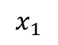
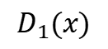
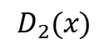


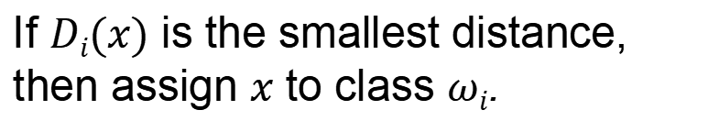
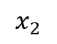
Minimum Distance Classifier
Represent each class by its mean vector of the registered patterns of that class:
Determine the Euclidean distance of pattern $x$ to class $ωj$.
$$D_{2}(x)$$
$$ωω$$
$$x_{2}$$
$$ωω$$
$$D_{1}(x)$$
$$ωω$$
If $Di(x)$ is the smallest distance, then assign $x$ to class $ωi$.
$$x_{1}$$
$$ωω$$

Slide 15
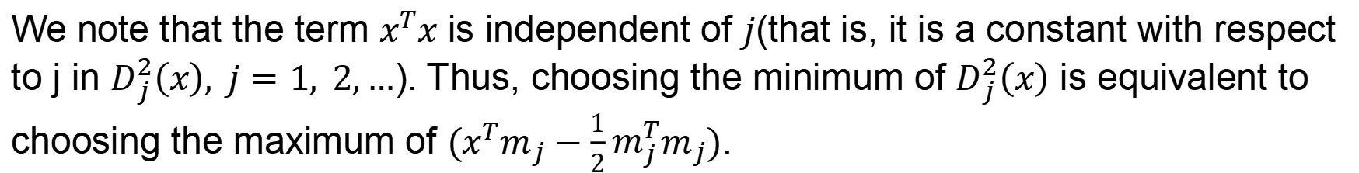
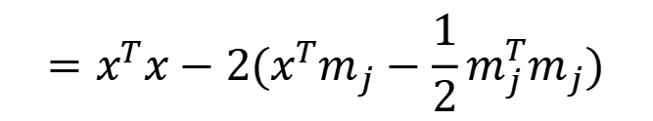

Minimum Distance Classifier
From the definition of the Euclidean distance,
$$D_{j}\left(x\right)=\left\|x−m_{j}\right\|={\left[({x−m_{j})}^{T}(x−m_{j})\right]}^{1/2}$$
Since $D_{j}(x)$ is non-negative, choosing the smallest $D_{j}(x)$ is the same as choosing the smallest $D_{j}^{2}(x)$ , where
$$D_{j}^{2}\left(x\right)={\left\|x−m_{j}\right\|}^{2}= {(x−m_{j})}^{T}(x−m_{j})$$
$$=x^{T}x−2x^{T}m_{j}+m_{j}^{T}m_{j}$$
$$=x^{T}x−2(x^{T}m_{j}−\frac{1}{2}m_{j}^{T}m_{j})$$
We note that the term $x^{T}x$ is independent of $j$(that is, it is a constant with respect to j in $D_{j}^{2}\left(x\right), j=1, 2,…$). Thus, choosing the minimum of $D_{j}^{2}\left(x\right)$ is equivalent to choosing the maximum of $(x^{T}m_{j}−\frac{1}{2}m_{j}^{T}m_{j})$.

Slide 16
Minimum Distance Classifier
The decision boundary separating class ω_{i} between ω_{j} for a Minimum Distance Classifier is:
D₁>D₂
X
D₂>D₁
m_{i}
R₁
R₂
m_{j}
D₁>D₃
D(X)=0
R₃
D₃>D₁
D₂>D₃
D₃>D₂

Slide 17
More Dimensional Features
Problems:
Not all of features are discriminating!
Using more features requires exponentially more data.
Feature selection: Select a subset of features that are most discriminative.
Notes:
discriminating
adj. 有识别力的；有鉴赏力的，品味高雅的

Slide 18
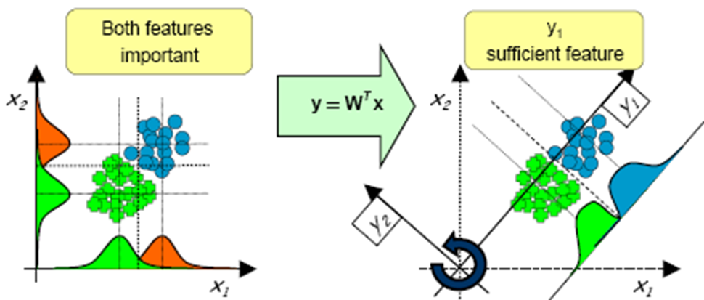
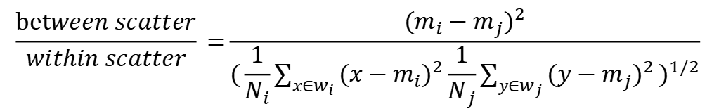
Feature Selection
Features which show less overlap between classes are more discriminative.
A simple measure for class separability is:
$$\frac{between scatter}{within scatter}\text{ =}\frac{{(m_{i}−m_{j})}^{2}}{{(\frac{1}{N_{i}}\sum_{x∈w_{i}}{{(x−m_{i})}^{2}\frac{1}{N_{j}}\sum_{y∈w_{j}}{{(y−m_{j})}^{2}}})}^{1/2}}$$
Notes:
Features correlated: discriminative behavior related
Decorrelating feature space (rotation of feature space) and then perform feature selection
Mapping using linear projection

Slide 19
Performance of Classifier
Divide the data set into a training set and a test set.
The performance of a classifier should be assessed by the classification error on an independent test set.
This set should not contain objects that are included in the training set, i.e. the objects that were used to compute the decision boundary.
Determine a decision boundary by minimizing the classification error of the training set.
Determine the classifier performance by computing the classification error of the testing set.

Slide 20
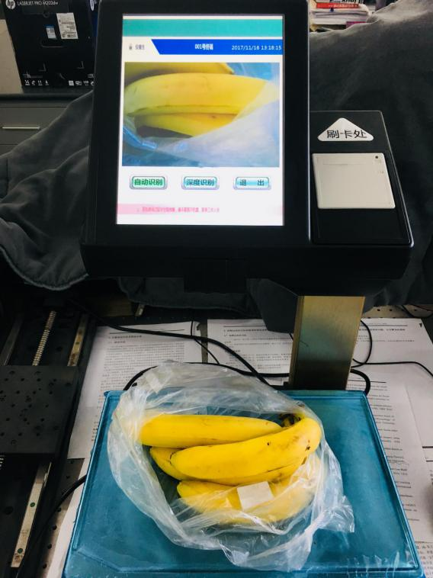
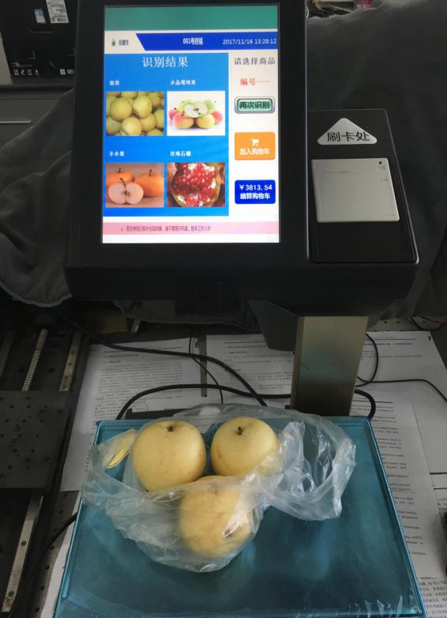
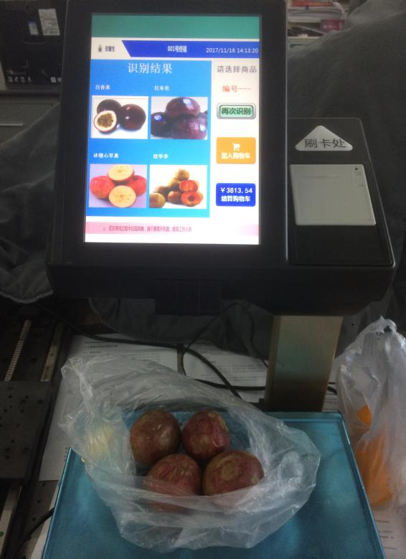
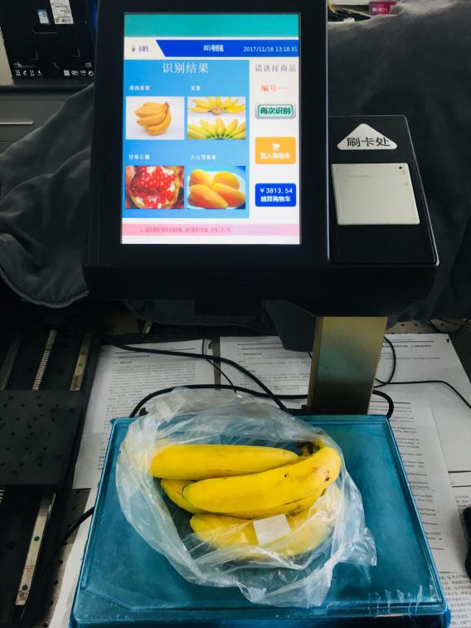
Pattern Classification
应用实例：智能电子秤
智能水果电子秤工作示意图

Slide 21
Pattern Classification
系统精度
识别精度 | 水果种类 | 种类合计
100% | 进口咖喱果，人参果，白兰瓜，纽荷脐橙，冬枣，胡萝卜，雪莲果，紫色西红柿，台湾小凤瓜，永春芦柑，油桃，金桔，西瓜，百香果，年桔，榴莲，柠檬，西梅，枇杷，珍珠果，黄香瓜，杨桃，菠萝，火龙果，大台农芒，龙眼，澳洲蜜柑，西州蜜瓜，山楂，澳洲大芒，丰水梨，冰糖心苹果，紫色圣女果 | 33
> 90% | 蜜柚，无籽红提，台湾青枣，板栗，无籽黑提，哈密瓜，米蕉， 黄金李，甜王瓜，沙田柚，夏橙，泰国香蕉，脆肉瓜，国产红提，砀山梨，雪梨，陕西香酥梨，花牛红苹果，冰糖橙，进口奇异果，小台农芒，红布伦，百香瓜，国产青提，脆李，番石榴，国产青苹果，海南香蕉，香梨，猕猴桃，蜜梨，贡梨，黑布伦，雪山白苹果，富士王 | 35
80%-90% | 特级红富士，鸭梨，黄金梨 | 3
<80% |  | 0
测试规则：
1. 将含有7808张水果样本的数据集随机分为80%和20%的比例，分别用于模型的训练和测试。
2. 统计测试样本的识别结果，将71类水果的平均识别准确率作为系统的准确率。
3. 总体识别时间与测试样本数的比值作为系统平均完成一次识别任务的时间。
水果识别系统 | 总体准确率 | 平均识别时间
 | 98.95% | 1.4s

Slide 22
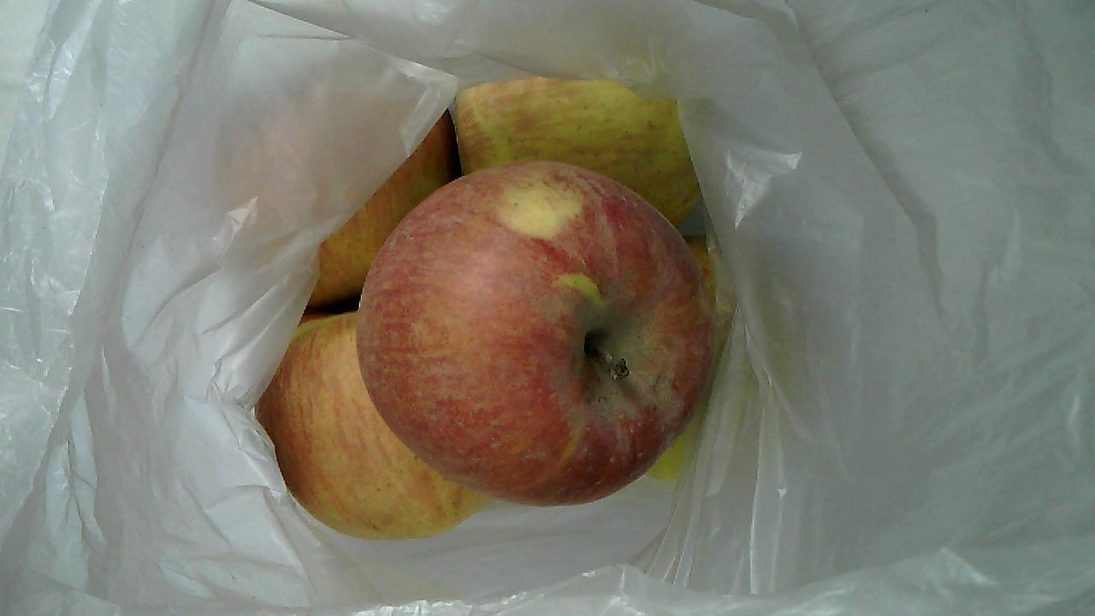
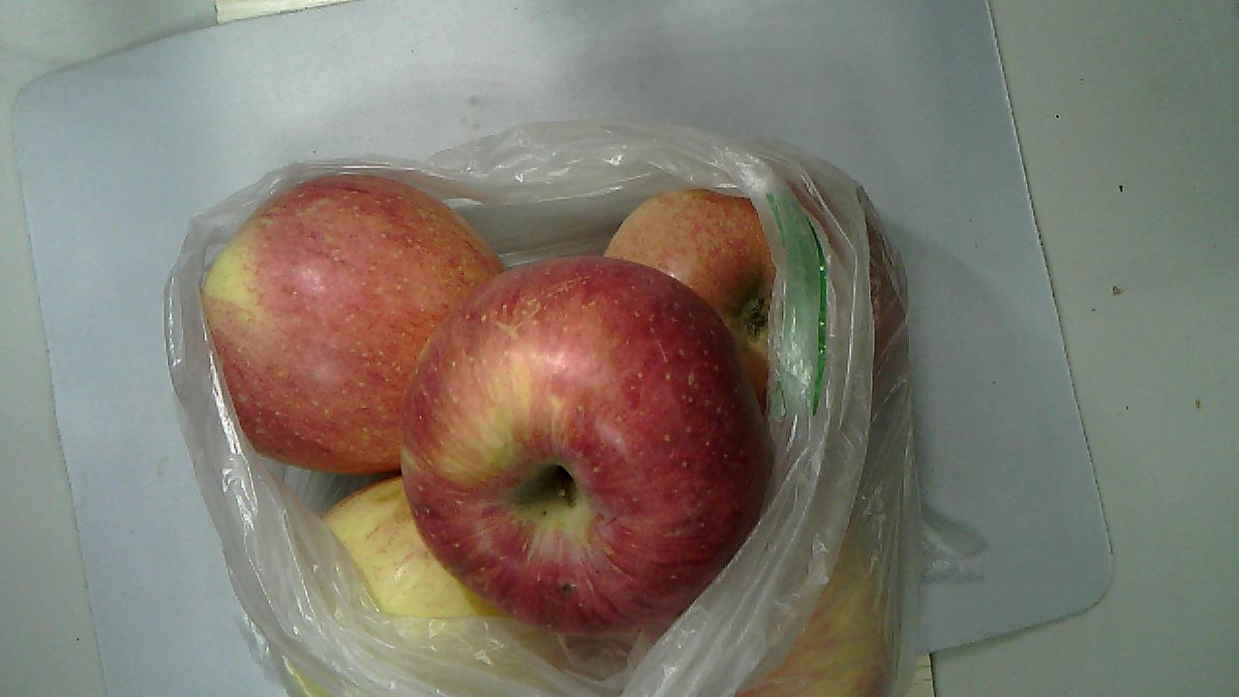
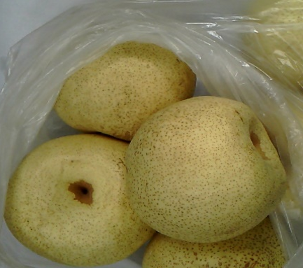
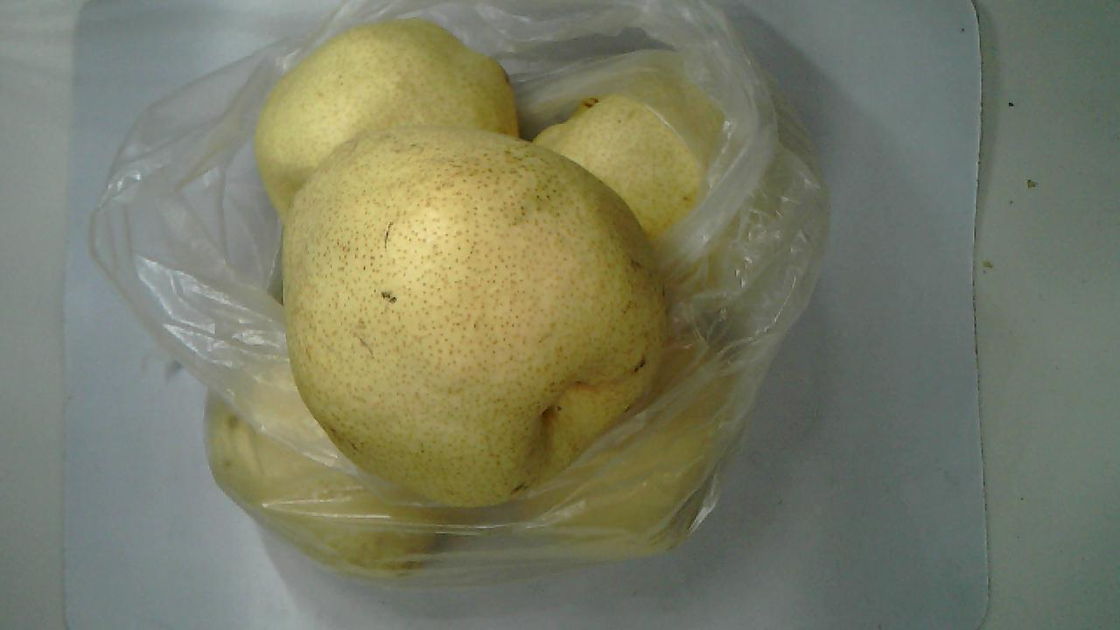
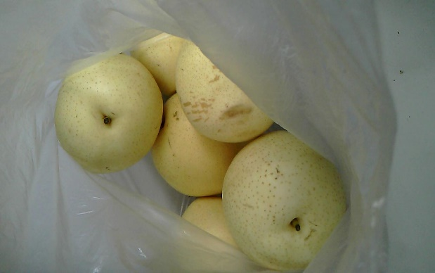
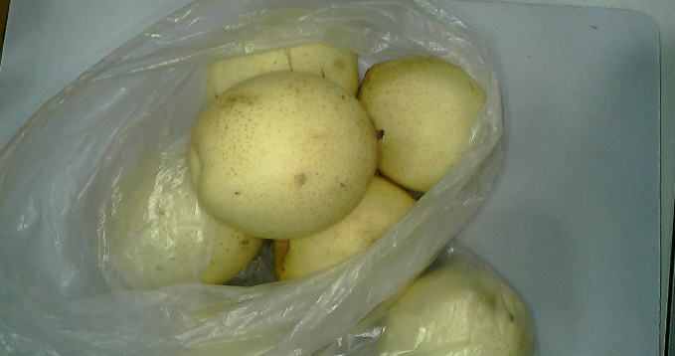
Pattern Classification
特点与优势
与市场中现有的电子秤相比，具有如下优势：
1. 高效、智能。智能电子秤平均1.4s即可自动地识别水果种类，简化人工操作的繁琐流程，提高商家运营效率。
2. 与肉眼识别相比，结果更加准确。市场中常见的水果多达上百种，很多水果品种和外观非常相似，人工记忆与区分的难度较大。智能水果电子秤可将流程智能化，解放劳动力，识别结果更稳定。
3. 降低商家运营成本。传统销售模式下，每台电子秤都需配备相应的操作人员，而智能电子秤可以由顾客自助操作，可有效降低人力成本。
冰糖心苹果
特级红富士
砀山梨
贡梨
蜜梨
鸭梨

Slide 23
Cluster Analysis
Data clustering is a common technique for statistical data analysis, which is used in many fields, including machine learning, data mining, pattern recognition, and image analysis.
Cluster Analysis methods do not need training sets for learning
Cluster Analysis methods divide the set of processed patterns into subsets (clusters) based on the mutual similarity of subset elements.
Each cluster contains patterns representing objects that are similar according to the selected object description and similarity criteria.
Objects that are not similar reside in different cluster.

Slide 24
Cluster Analysis

Slide 25
Distance Measure
An important step in any clustering is to select a distance measure, which determines how the similarity of two elements is calculated.
This will influence the shape of the clusters, as some elements may be close to one another according to one distance and further away according to another.
E.g., Euclidean distance, Manhattan distance..

Slide 26
K-means
The k-means cluster analysis method is a well known example of cluster analysis.
Popular
Simple
And practically useful

Slide 27
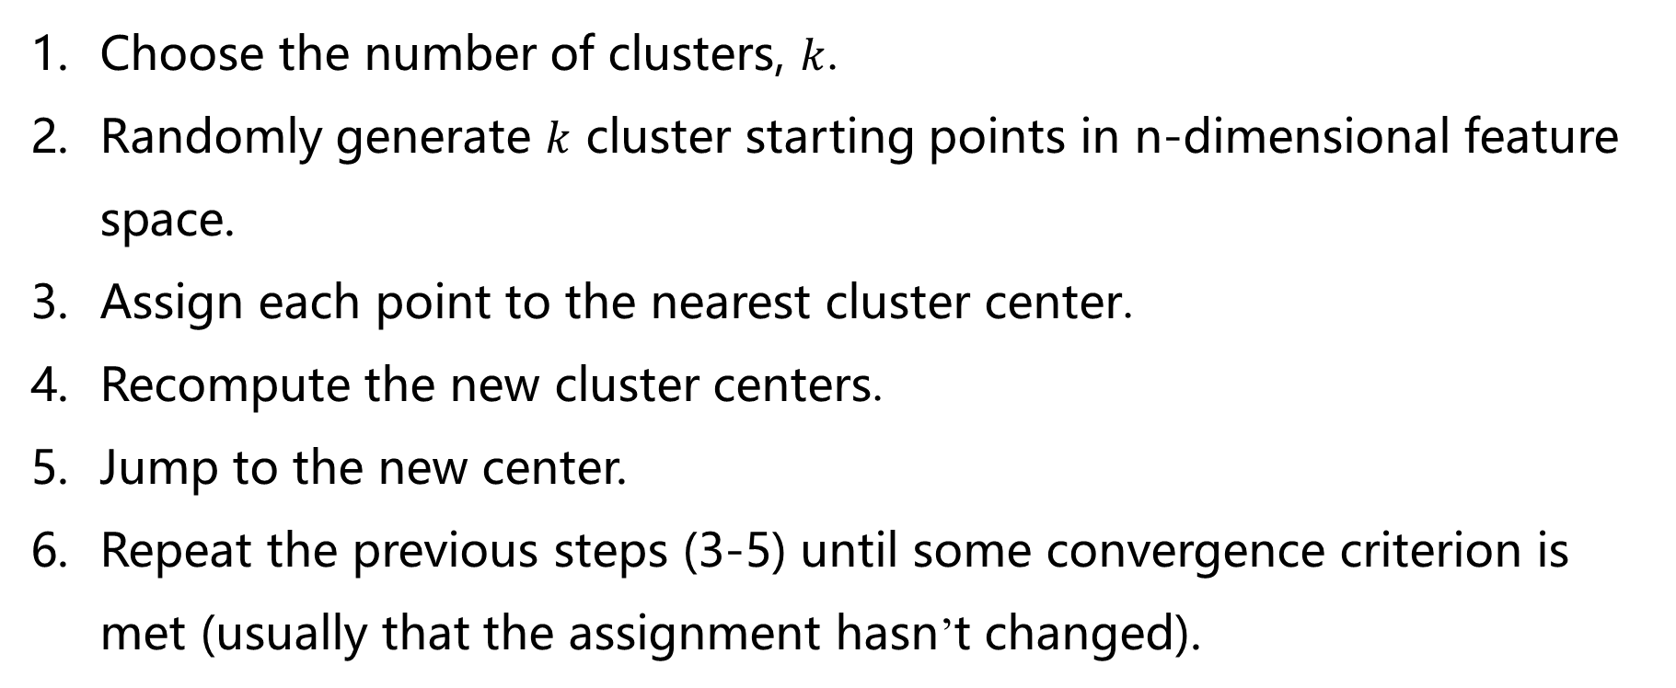
K-means
Choose the number of clusters, $k$.
Randomly generate $k$ cluster starting points in n-dimensional feature space.
Assign each point to the nearest cluster center.
Recompute the new cluster centers.
Jump to the new center.
Repeat the previous steps (3-5) until some convergence criterion is met (usually that the assignment hasn’t changed).

Slide 28
K-means

Slide 29
K-means

Slide 30
K-means

Slide 31
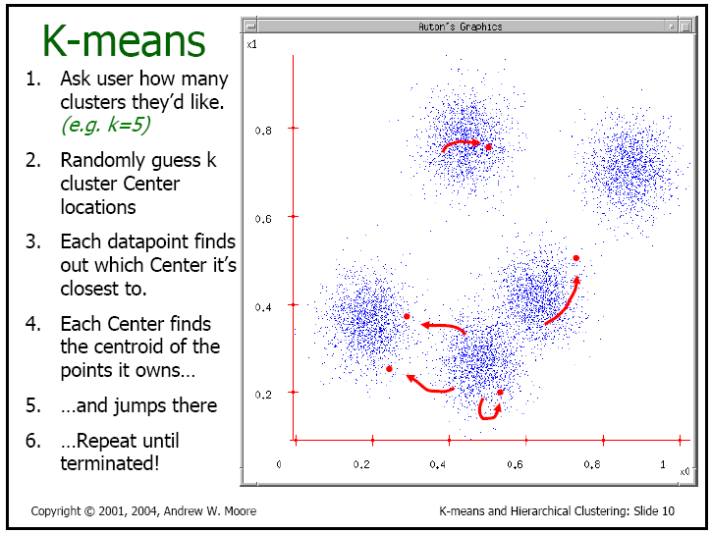
K-means

Slide 32
K-means

Slide 33
Discussion
The main advantages of this algorithm are its simplicity and speed which allows it to run on large datasets.
Its disadvantage is that it does not yield the same result with each run, since the resulting clusters depend on the initial random assignments.
It minimizes intra-cluster variance, but does not ensure that the result has a global minimum of variance.

Slide 34
An Application: Biometrics
A Great Challenge: User Authentication
⇒ Positive authentication is very important!
Since more and more highly fraudulent technologies in today’s complex society, the problem of identifying a person continues to pose a great challenge.
User authentication is based on three methods:
-- What you have
-- What you know
-- What you are / What you do

Slide 35
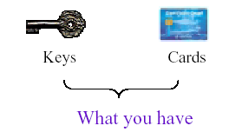
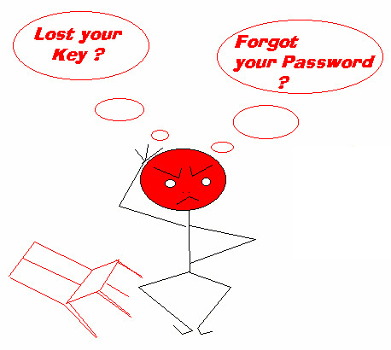
Traditional Methods
Token-based: What you have
-- Examples: credit card,
smart card,
keys

Slide 36
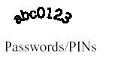
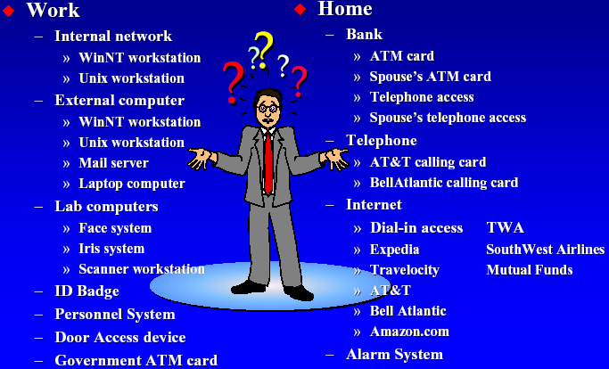
Traditional Methods
Knowledge-based: What you know
-- Examples: password, PIN
How many passwords can you remember?

Slide 37
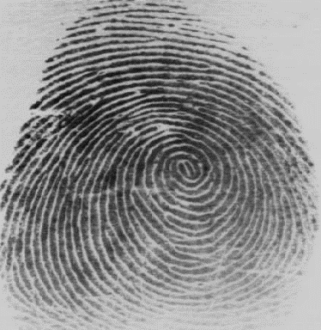
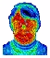
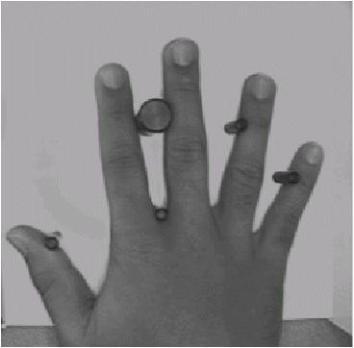
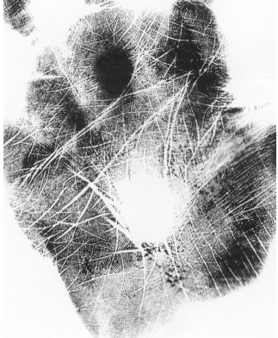

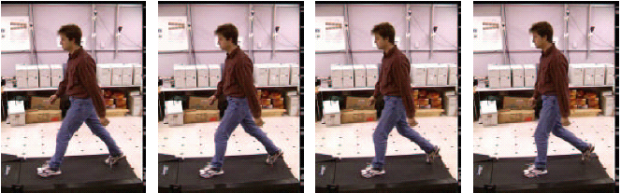
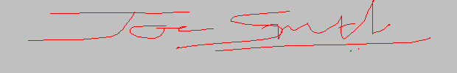



Biometrics: What you are/do!

Slide 38
Biometrics
Universality: Every person should possess this characteristic
Uniqueness: No two persons possess the same characteristic
Permanence: Does not change in time.
i.e., it is time invariant
Long vs. short-term stability
Collectability: Can be quantitatively measured
Non-intrusive
Reliable and robust
Cost effective for a given application

Slide 39
Biometrics
Biometrics
Physical
Behavioral
Others
(Gesture, gait, Keystroke)
Head
Hand
Signature
Voice
Face
Iris
Hand Geometry
Others
(Ear, Retina,
Dental)
Fingerprint
Palmprint
Taxonomy of Biometrics Technology

Slide 40
Applications of Biometrics
❑ Access control
Protection of security information
❑ Law enforcement
The identification of know criminals
❑ Welfare agency
Track & control benefit distribution
❑ Bank & credit card for check cashing
❑ Health care
Track access to medical information
Notes:
access control
访问控制
welfare agency
福利机构

Slide 41


Challenges of Biometrics
Twins
Father and son
⇒ Different persons may have very similar appearance

Slide 42

Challenges of Biometrics
Notes:
O Face recognition can be categorized into appearance-based, geometry-based, and hybrid approaches.

Slide 43

Challenges of Biometrics

Slide 44

Challenges of Biometrics

Slide 45



Challenges of Biometrics
Cuts and bruises on finger; dry or oily finger; ~4% of fingerprints are not of “good” quality
New compact solid-state sensors capture only a small portion of the fingerprint; requires user habituation
Fingerprint impression is often left on the sensor

Slide 46

Challenges of Biometrics
⇒ The same person may have the different signatures

Slide 47


Working Modes of Biometrics
Task#1: identification
Who is he?
1:N
Typical applications
Watch list screening system
Task#2: verification
Is he who he says he is?
1:1
Typical applications
E-channel system in Custom
Who is he?
Is it Ms. Jinglei Xu?

Slide 48
Framework of Biometric System
Enrollment
Palmprint
Acquisition
Palmprint
Preprocessing
Feature
Extraction
Database
Palmprint
Acquisition
Palmprint
Preprocessing
Feature
Extraction
Matching
Matching Result
Identification

Slide 49
Biometric: Palmprint
Why Palmprint:
Convenient & comfortable
Not easy to get hurt
Stable for a long period of time
High accuracy
Palmprint tells more than fingerprint
Complementary to other biometric systems

Slide 50






Palmprint Acquisition

Slide 51



Potential Palmprint Features
Geometry features
Finger width
Length, width, thickness and area of a palm
Texture features
Geometry Feature
Texture/Line Features
Line Features
Principal lines
Wrinkles
Point Features
Minutiae point
Delta point
Datum point
Singular/Minutiae Points
Notes:
principal line
主纵线
wrinkles
n. 皱纹；皱褶（wrinkle 的复数形式）

Slide 52






Palmprint Preprocessing
Palmprint location and segmentation:
(a) Original image (b) Binary & filter image (c) Boundary Tracking
(d) Key points detecting (e) Setup the coordinate system (f) Extract sub image

Slide 53

Palmprint Preprocessing
Localization :
Three key points
X-Y coordinate
Regions :
Sub-image 128*128

Slide 54















Palmprint Preprocessing
Sub images from the same person at different time
Similar sub images from different person
Typical sub images from different person

Slide 55
Line Feature Extraction Method
The process of palm line extraction: (a) original palmprint, (b)-(e) directional line images in 0°, 45°, 90° and 135°, (f) resultant palm line image, and (g) original palmprint overlapping with the extracted palm lines.

Slide 56

Line Feature Matching Method

Slide 57
Matching Result
EER=0.4%
Database: 320 palms and 3200 palmprint images

Slide 58
Texture based Feature Extraction
Gabor Filter
Adjusted Gabor Filter to zero DC to provide more robust to brightness.
The parameters, such as the sizes and orientation, are critical to provide good experiment results.

Slide 59
Texture based Feature Extraction
Each point in the resultant image is coded to two bits, (b_{r} ,b_{i})
where I is the central part of a palmprint.

Slide 60








Texture based Feature Extraction
Each feature vector is two 2D matrices: real and imaginary part

Slide 61

Texture based Feature Extraction
Hamming distance is used to measure the similarity of two palmprints. Based on the normalized distance
-- $P$ and $Q$ be two palmprint feature matrices; $PR(QR)$and $PI(QI)$are real part and imaginary part of $P(Q)$, respectively
-- The Boolean operator is equal to zero if two bits are equal.
-- $D0$ is between 0 to 1 where 0 means prefect match.

Slide 62
Texture based Feature Extraction
Low-resolution texture method is suitable for palmprint images even without clear lines.
This method can produce fixed length feature so matching time is shorter than line-based approach.
Operation
Execution Time
Feature Extraction
64ms
Matching
1.7ms

Slide 63
Texture based Feature Extraction
EER=0.6%

Slide 64


Palmprint: A New Solution

Slide 65


Palmprint: A New Solution

Slide 66

Palmprint: A New Solution

Slide 67









Biocomputing Research Center

Slide 68

Multimodal Biometric System

